Slide 1
Inverse of Elementary Matrices
Notes:
Outline:
Inverse
Invertibility
elementary row operation
in generatl

Slide 2
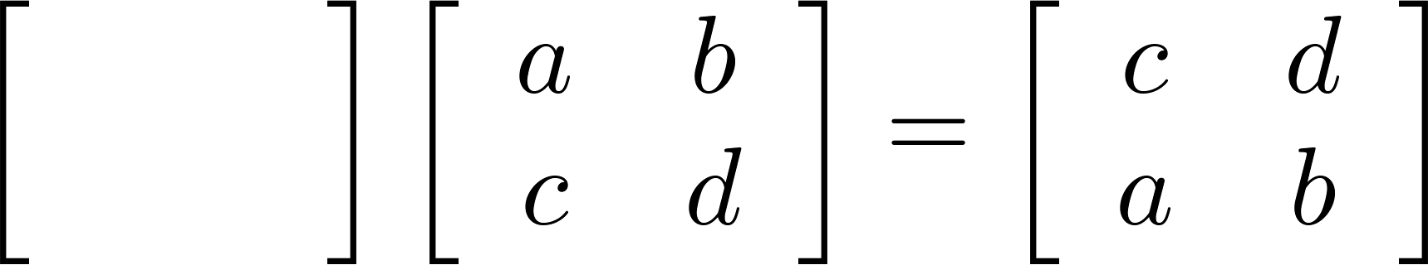
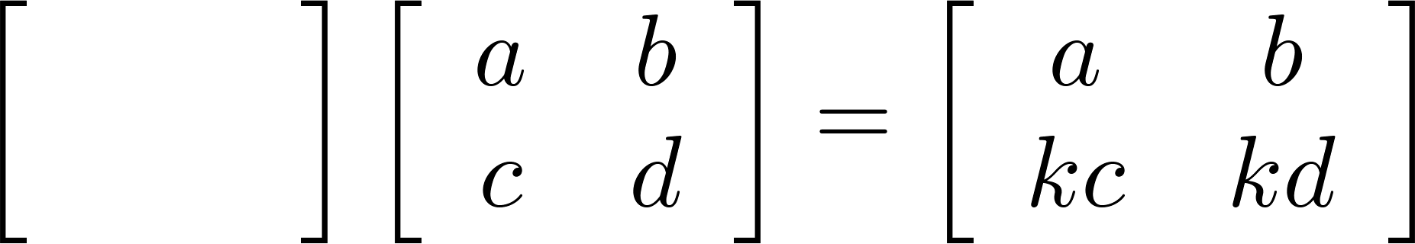
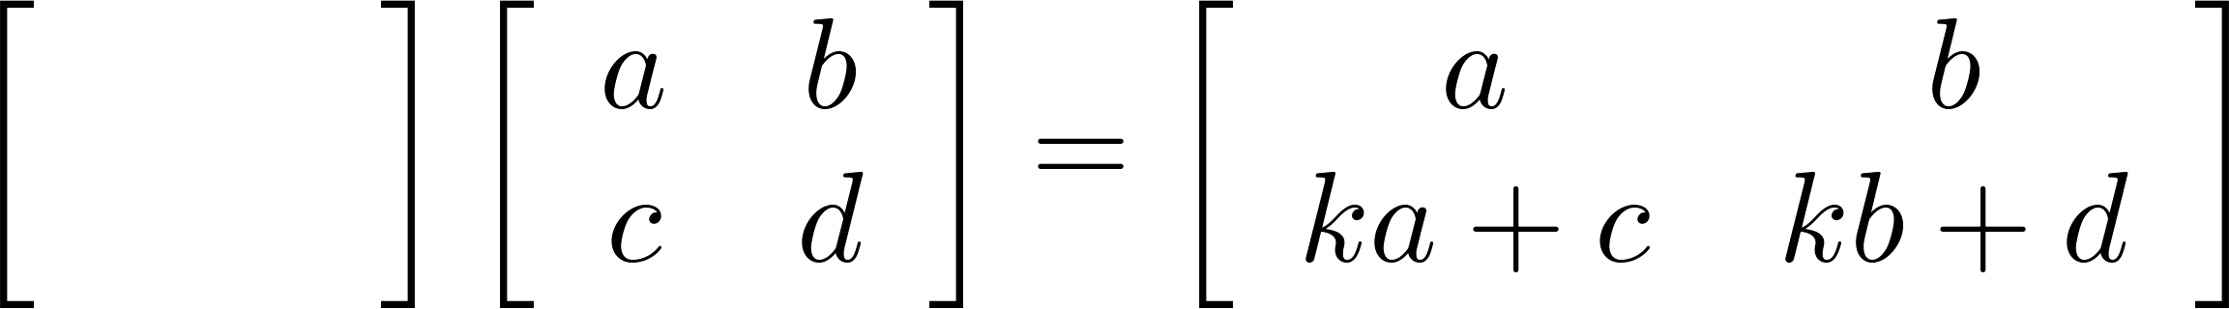
Elementary Row Operation
Every elementary row operation can be performed by matrix multiplication.
1. Interchange
2. Scaling
3. Adding k times row i to row j:
elementary matrix
0
1
1
0
1
0
0
k
1
0
k
1

Slide 3




Elementary Matrix
Every elementary row operation can be performed by matrix multiplication.
How to find elementary matrix?
elementary matrix
E.g. the elementary matrix that exchanges the 1st and 2nd rows
$$E\left[\begin{matrix}1 & 4 \\ 2 & 5 \\ 3 & 6\end{matrix}\right]=\left[\begin{matrix}2 & 5 \\ 1 & 4 \\ 3 & 6\end{matrix}\right]$$
$$E\left[\begin{matrix}1 & 0 & 0 \\ 0 & 1 & 0 \\ 0 & 0 & 1\end{matrix}\right]$$
$$\left[\begin{matrix}0 & 1 & 0 \\ 1 & 0 & 0 \\ 0 & 0 & 1\end{matrix}\right]$$
=
$$E=\left[\begin{matrix}0 & 1 & 0 \\ 1 & 0 & 0 \\ 0 & 0 & 1\end{matrix}\right]$$

Slide 4






Elementary Matrix
How to find elementary matrix?
Apply the desired elementary row operation on Identity matrix
$$\left[\begin{matrix}1 & 0 & 0 \\ 0 & 1 & 0 \\ 0 & 0 & 1\end{matrix}\right]$$
$$E_{1}=\left[\begin{matrix}1 & 0 & 0 \\ 0 & 0 & 1 \\ 0 & 1 & 0\end{matrix}\right]$$
Exchange the 2nd and 3rd rows
Multiply the 2nd row by -4
$$\left[\begin{matrix}1 & 0 & 0 \\ 0 & 1 & 0 \\ 0 & 0 & 1\end{matrix}\right]$$
$$E_{2}=\left[\begin{matrix}1 & 0 & 0 \\ 0 & −4 & 0 \\ 0 & 0 & 1\end{matrix}\right]$$
Adding 2 times row 1 to row 3
$$\left[\begin{matrix}1 & 0 & 0 \\ 0 & 1 & 0 \\ 0 & 0 & 1\end{matrix}\right]$$
$$E_{3}=\left[\begin{matrix}1 & 0 & 0 \\ 0 & 1 & 0 \\ 2 & 0 & 1\end{matrix}\right]$$

Slide 5




Elementary Matrix
How to find elementary matrix?
Apply the desired elementary row operation on Identity matrix
$$A=\left[\begin{matrix}1 & 4 \\ 2 & 5 \\ 3 & 6\end{matrix}\right]$$
$$E_{1}A=\left[\begin{matrix}1 & 4 \\ 3 & 6 \\ 2 & 5\end{matrix}\right]$$
$$E_{1}=\left[\begin{matrix}1 & 0 & 0 \\ 0 & 0 & 1 \\ 0 & 1 & 0\end{matrix}\right]$$
$$E_{2}=\left[\begin{matrix}1 & 0 & 0 \\ 0 & −4 & 0 \\ 0 & 0 & 1\end{matrix}\right]$$
$$E_{2}A=\left[\begin{matrix}1 & 4 \\ −8 & −20 \\ 3 & 6\end{matrix}\right]$$
$$E_{3}=\left[\begin{matrix}1 & 0 & 0 \\ 0 & 1 & 0 \\ 2 & 0 & 1\end{matrix}\right]$$
$$E_{3}A=\left[\begin{matrix}1 & 4 \\ 2 & 5 \\ 5 & 14\end{matrix}\right]$$

Slide 6

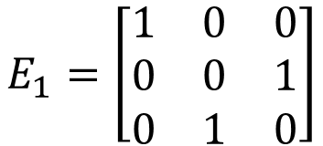

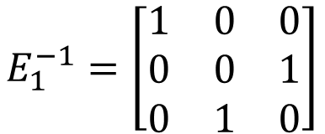
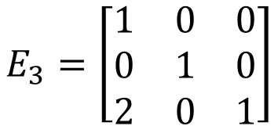
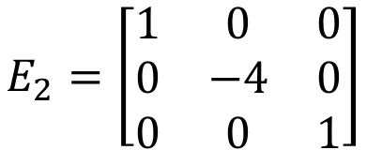
Inverse of Elementary Matrix
Reverse elementary row operation
Exchange the 2nd and 3rd rows
Exchange the 2nd and 3rd rows
$$E_{1}=\left[\begin{matrix}1 & 0 & 0 \\ 0 & 0 & 1 \\ 0 & 1 & 0\end{matrix}\right]$$
$$E_{1}^{−1}=\left[\begin{matrix}1 & 0 & 0 \\ 0 & 0 & 1 \\ 0 & 1 & 0\end{matrix}\right]$$
Multiply the 2nd row by -4
Multiply the 2nd row by -1/4
$$E_{2}=\left[\begin{matrix}1 & 0 & 0 \\ 0 & −4 & 0 \\ 0 & 0 & 1\end{matrix}\right]$$
$$E_{2}^{−1}=\left[\begin{matrix}1 & 0 & 0 \\ 0 & −1/4 & 0 \\ 0 & 0 & 1\end{matrix}\right]$$
Adding 2 times row 1 to row 3
Adding -2 times row 1 to row 3
$$E_{3}=\left[\begin{matrix}1 & 0 & 0 \\ 0 & 1 & 0 \\ 2 & 0 & 1\end{matrix}\right]$$
$$E_{3}^{−1}=\left[\begin{matrix}1 & 0 & 0 \\ 0 & 1 & 0 \\ −2 & 0 & 1\end{matrix}\right]$$
Notes:
The inverse of elementary matrix is another elementary matrix that do the reverse row operation.

Slide 7



RREF v.s. Elementary Matrix
Let A be an mxn matrix with reduced row echelon form R.
There exists an invertible m x m matrix P such that PA=R
$$E_{k}⋯E_{2}E_{1}A=R$$
$$P=E_{k}⋯E_{2}E_{1}$$
$$P^{−1}=E_{1}^{−1}E_{2}^{−1}⋯E_{k}^{−1}$$

Slide 8



Invertible
An n x n matrix A is invertible.
R=RREF(A)=I_{n}
$$E_{k}⋯E_{2}E_{1}A=I_{n}$$
The reduced row echelon form of A is I_{n}
$$A=E_{1}^{−1}E_{2}^{−1}⋯E_{k}^{−1}I_{n}$$
$$=E_{1}^{−1}E_{2}^{−1}⋯E_{k}^{−1}$$
A is a product of elementary matrices

